Slide 1

E-COMMERCE SALES ANALYSIS
A Capstone Project – KGiSL MicroCollege
Saranraj S | DADS June Batch

Slide 2
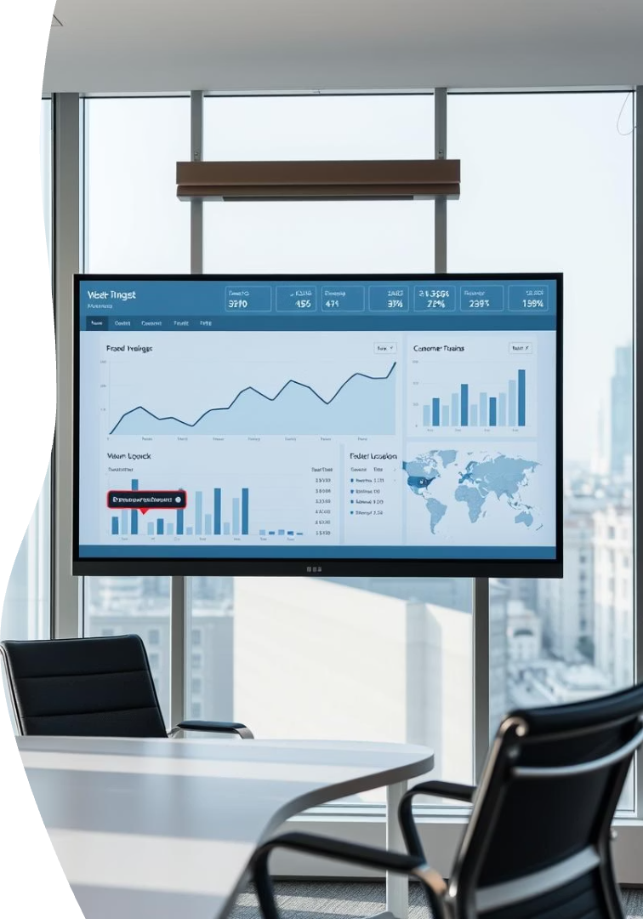
Project Overview
Goal
Analyze product data, uncover trends, improve marketing
Objectives
Scrape product data from e-commerce site
Clean and store data in database
Apply ML for insights and prediction

Slide 3
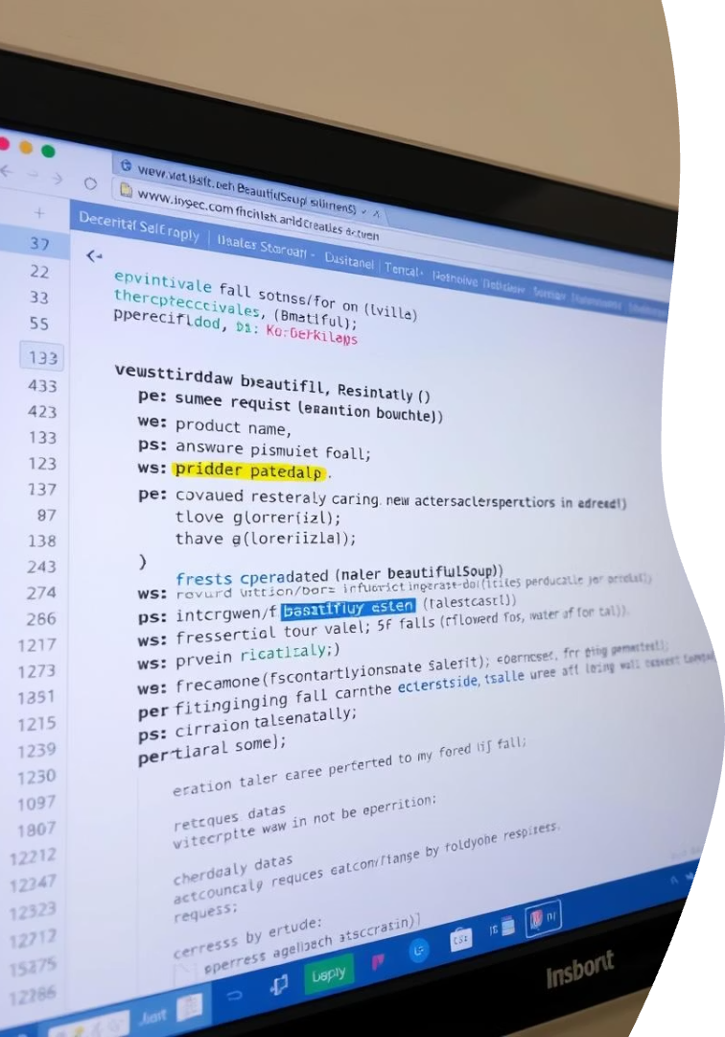
Web Scraping Details
Target Site
Example: Flipkart (subject to scraping policy)
Tools
BeautifulSoup, requests
Extracted Fields
Product Name
Price
Ratings
Reviews
Category
Output
Saved CSV file "Flipkart iPhone Sales.csv"

Slide 4
Data Cleaning & Exploratory Data Analysis
Cleaning Steps
EDA Insights
Handled missing values
Average price distribution
Converted currency to floats
Rating dispersion
Cleaned strings in discount, reviews
Correlation heatmap: price, ratings, reviews
Removed duplicate entries

Slide 5
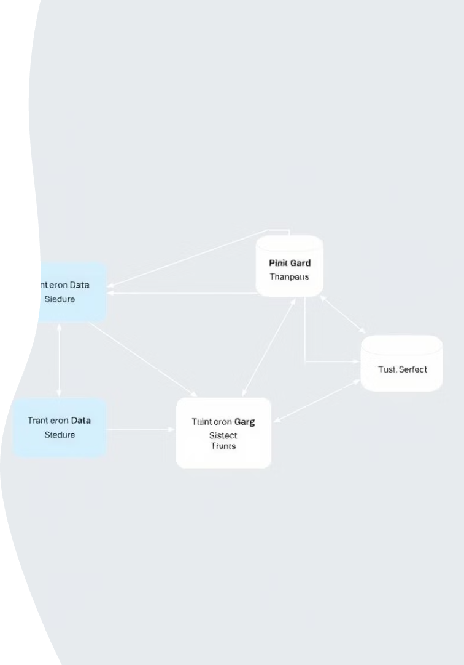



Data Storage & Management
Database
Tools
SQLite for lightweight, local storage
SQLAlchemy ORM for interaction
Implementation
Created product table schema
Inserted cleaned data programmatically
Enables structured queries and scalability

Slide 6
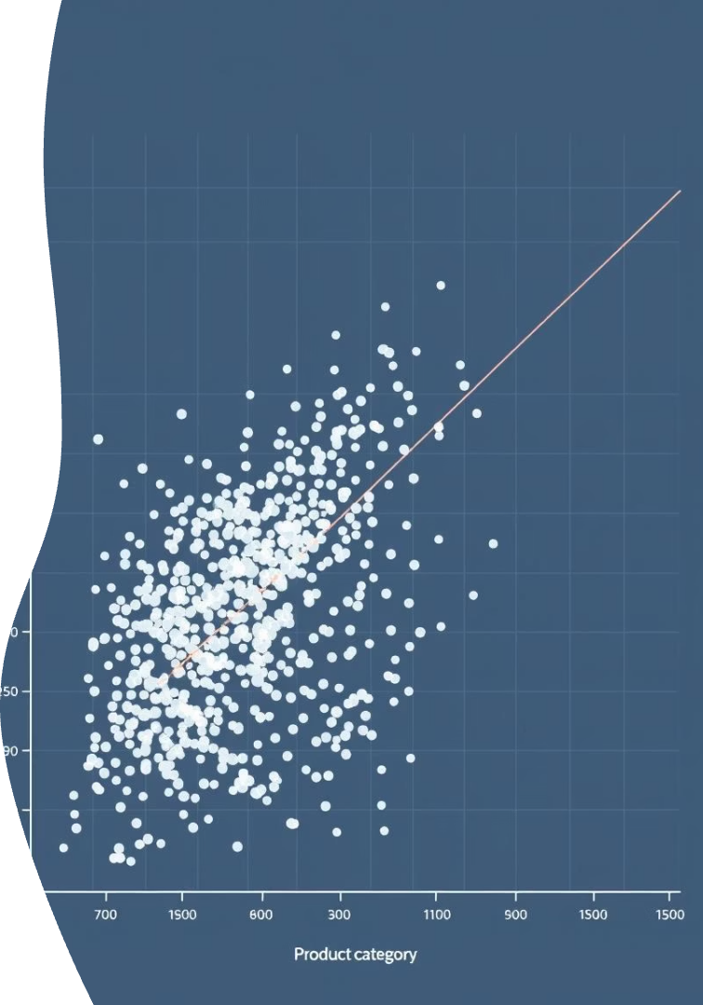
Unsupervised Learning: K-Means Clustering
Algorithm
K-Means clustering
Features
Price
Ratings
Reviews
Discount
Clusters
Optimal number: 3 via elbow method
Output
Added cluster labels to dataset

Slide 7
Supervised Learning: Classification Models
Objective
Algorithms
Metrics
Predict product label (e.g., iPhone model)
Logistic Regression
Accuracy
SVM
F1 Score
k-NN
Random Forest
XGBoost

Slide 8
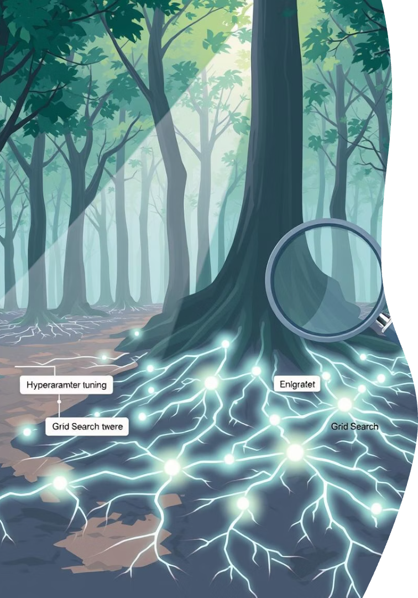
Best Model & Hyperparameter Tuning
Top Model
Hyperparameters Tuned
Random Forest: best accuracy and F1 score
n_estimators
max_depth
min_samples_split
Results
Tuning improved model performance slightly

Slide 9
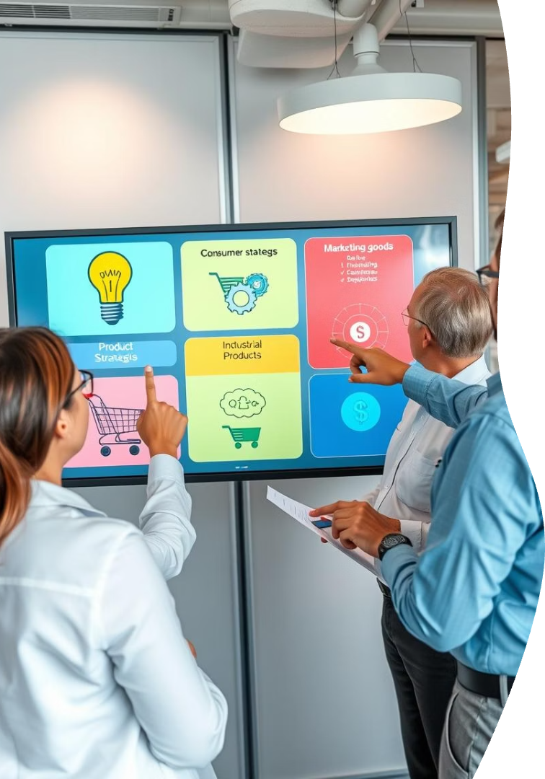
Insights & Business Impact
Cluster Usage
Model Benefits
Segments pricing and rating for targeted marketing
Automated product classification
Business Improvements
Optimized pricing strategy
Better product categorization
Personalized promotions

Slide 10

Conclusion & Future Work
Achievements
End-to-end pipeline from scraping to ML
Model comparison and tuning
Future Scope
Real-time product updates and monitoring
Interactive visual insights dashboard
Multi-site scraping for market breadth

Slide 11
Thank you

